Slide 1
Disaster Preparedness
Group members:
Yitian Guo
Yusi Liu
Chuhan Li

Slide 2
Proposal
Part one

Slide 3
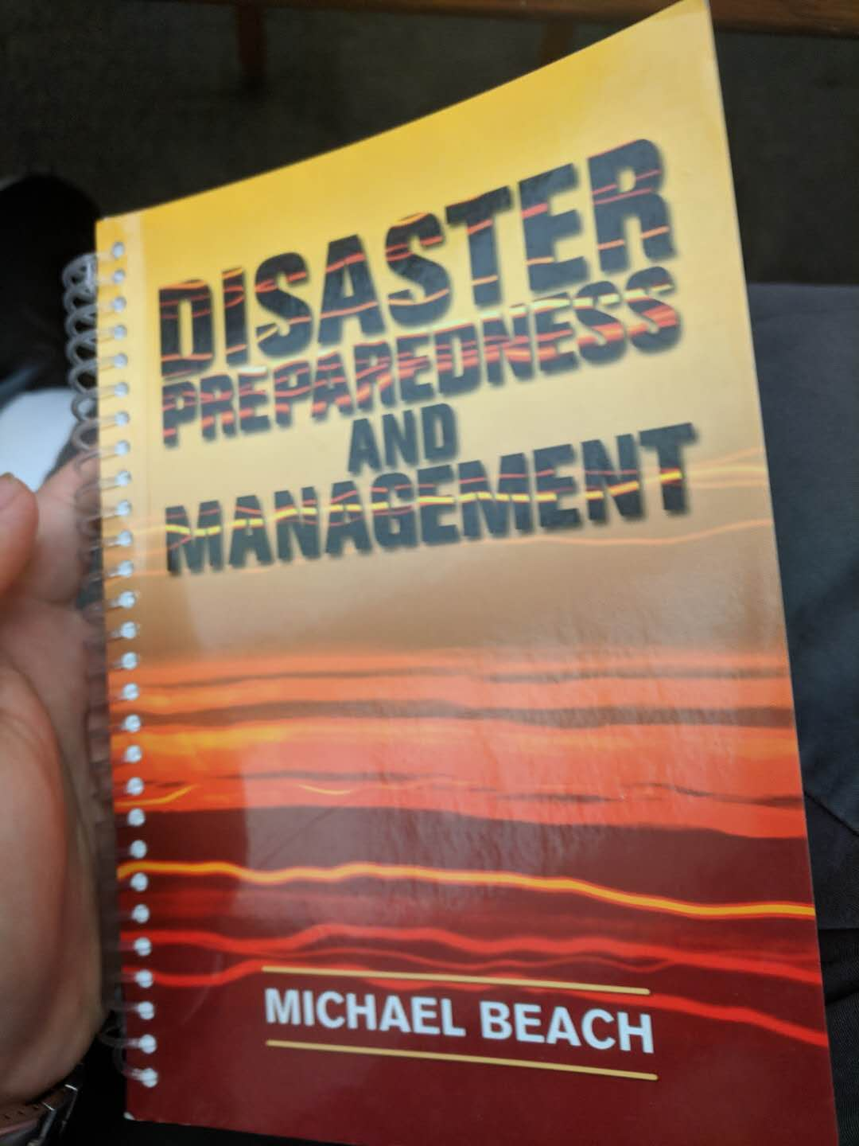
User Study
1
2
Interview
Q: Who will be the users of this app?
A: Adults and teenagers, not for children.
Q: What will be the situations when users need this app?
A:
Before a disaster, users use the app to prepare reasonable amount of food, water and other emergency supplies.
During a disaster, they know the hospitals and food supplies’ conditions from the app.
After a disaster, they can learn from their experience and adjust the amount of different demands to ensure a better preparation for the next disaster.
Q: What is the most important expectation for the app?
A: To be practical and easy to use

Slide 4
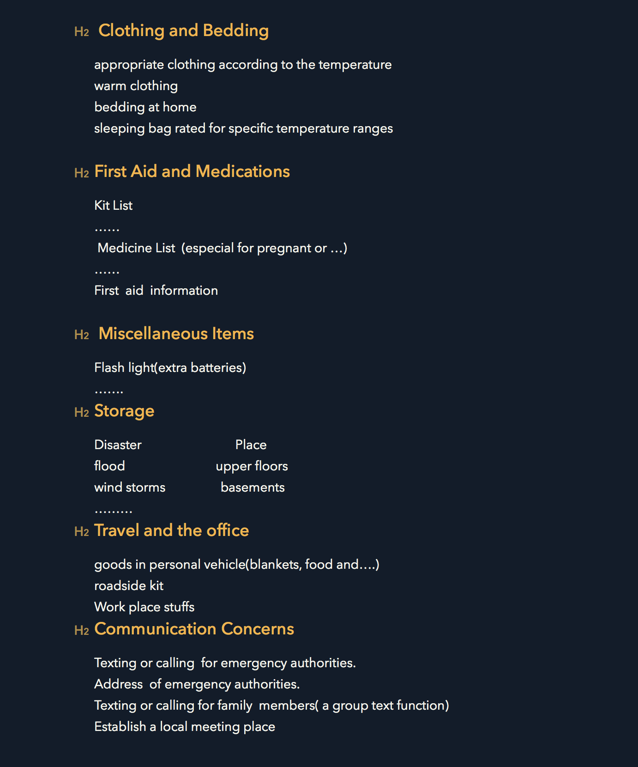
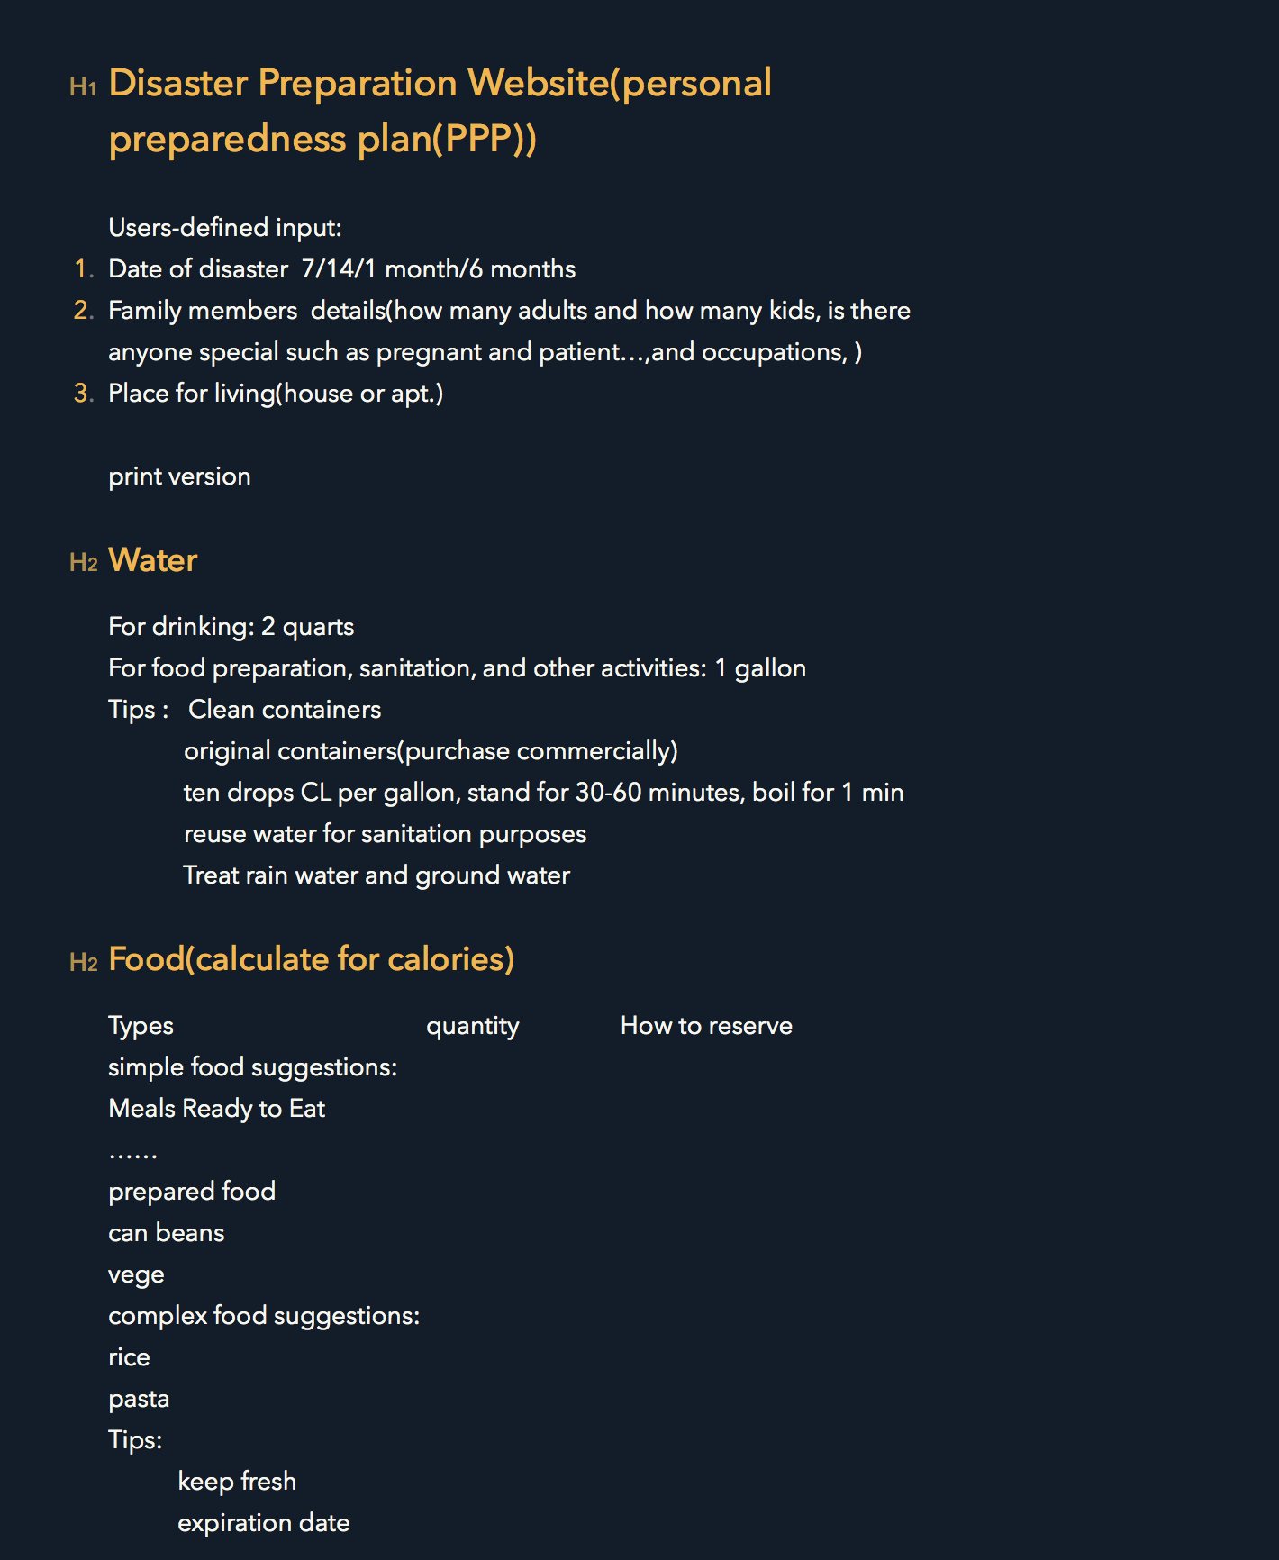

Slide 5
Task Analysis
Part two

Slide 6
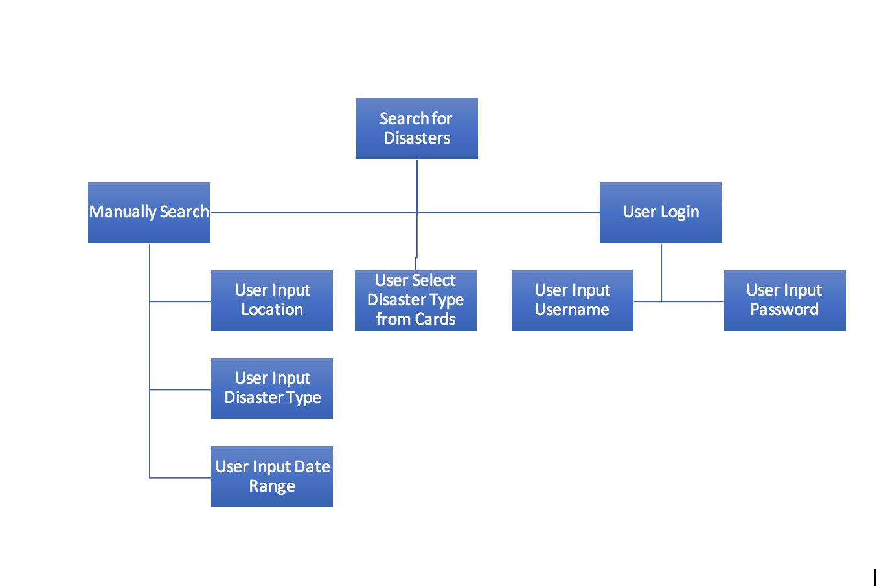

Slide 7
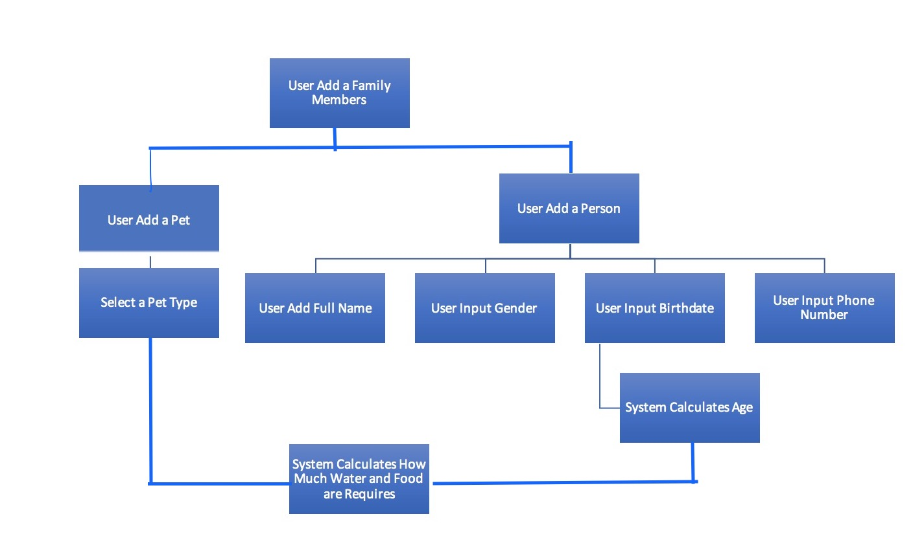

Slide 8
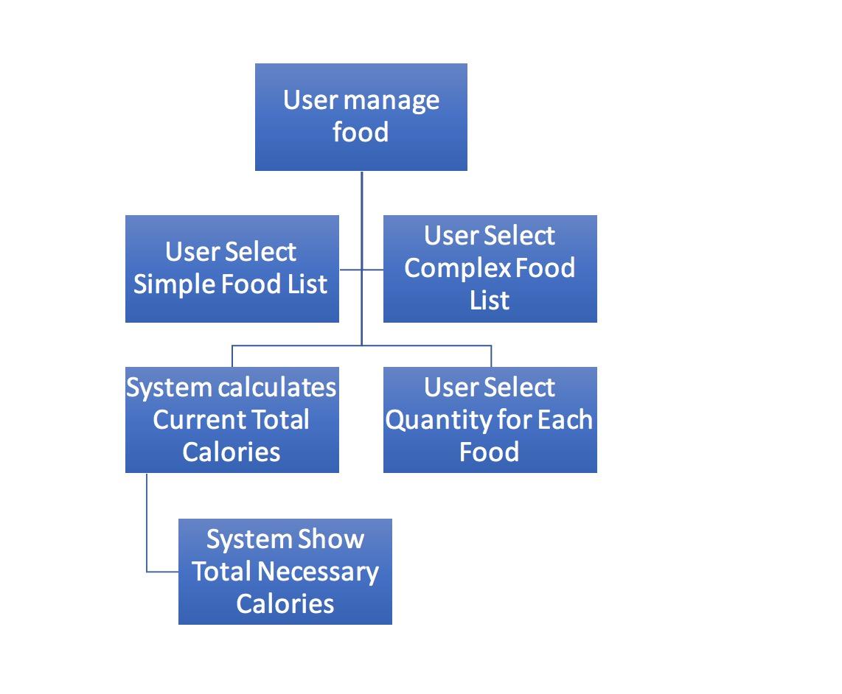

Slide 9
Design
Part three

Slide 10
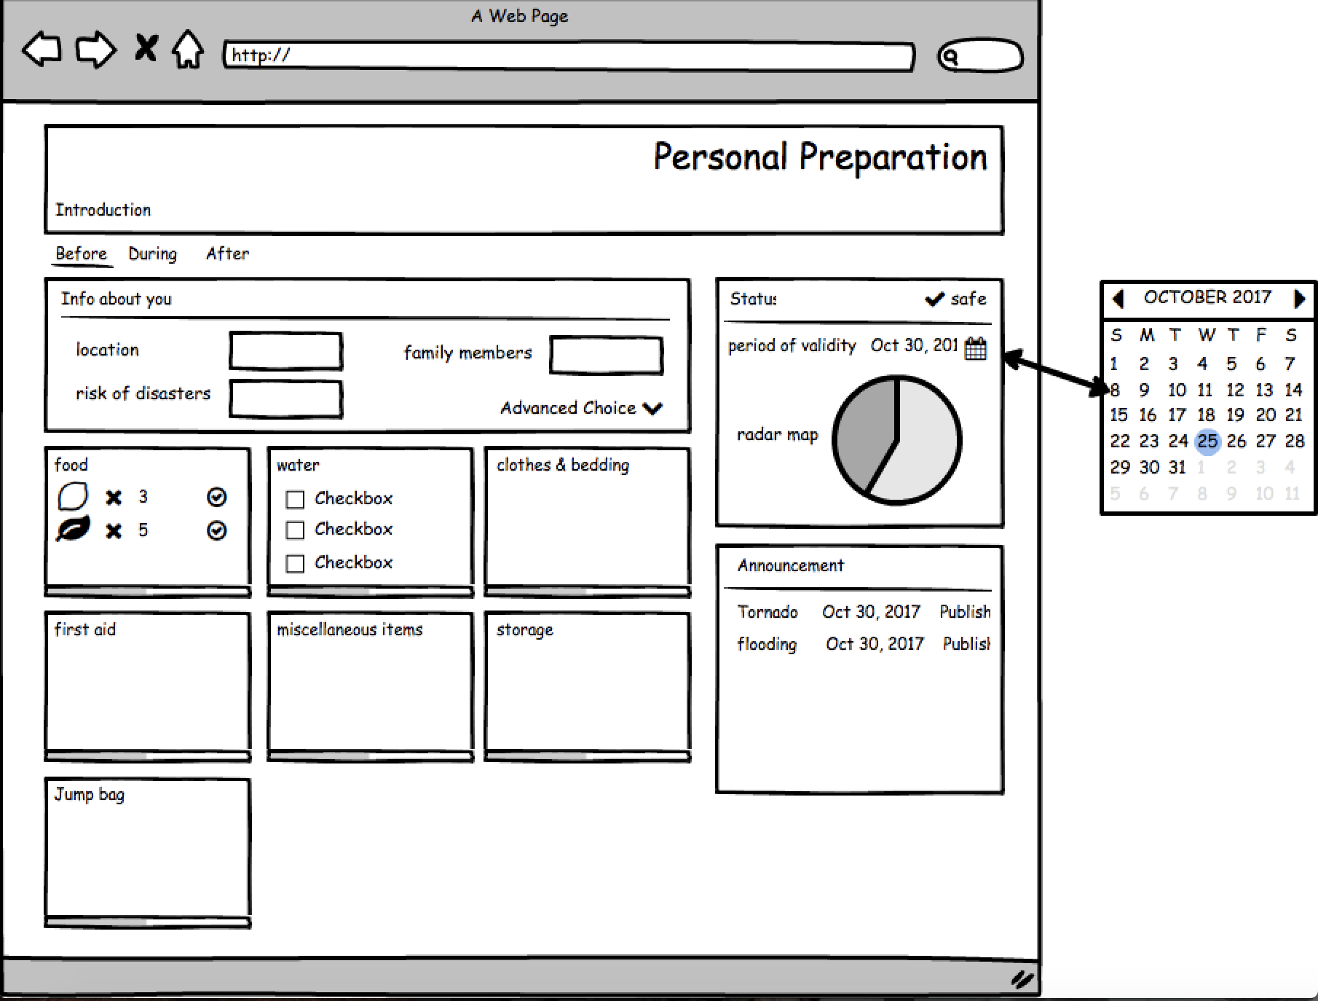
First Design

Slide 11
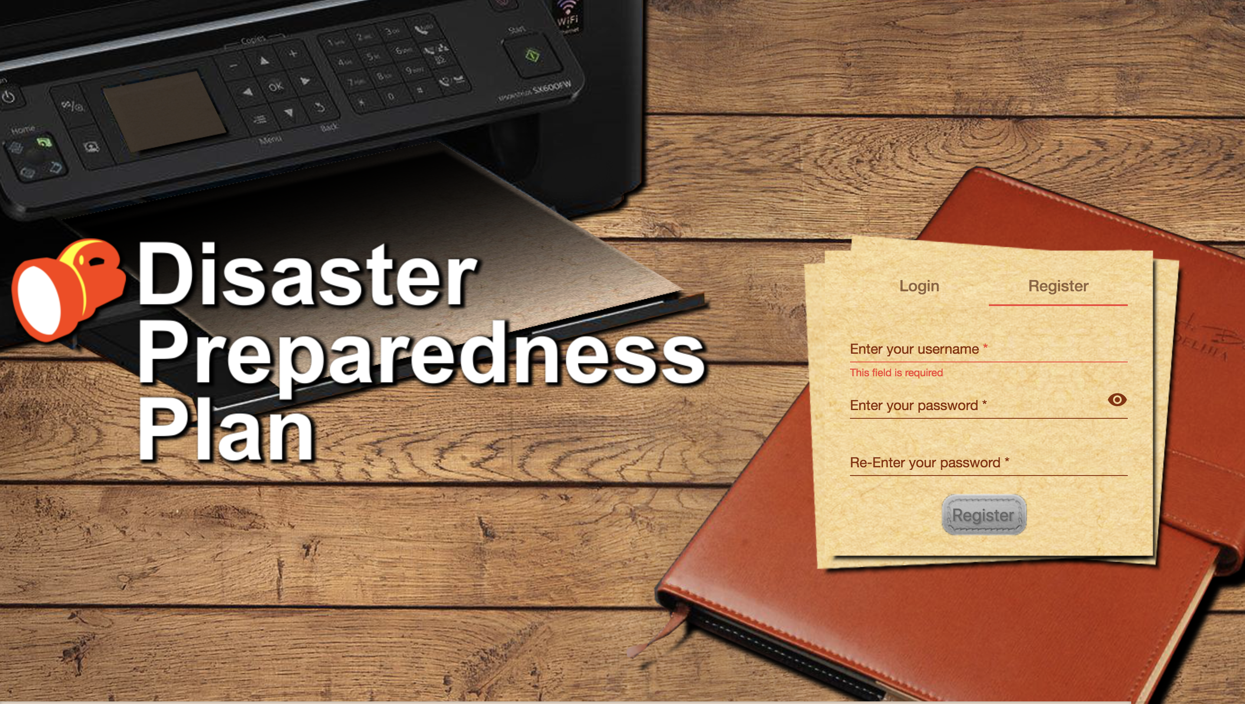

Slide 12
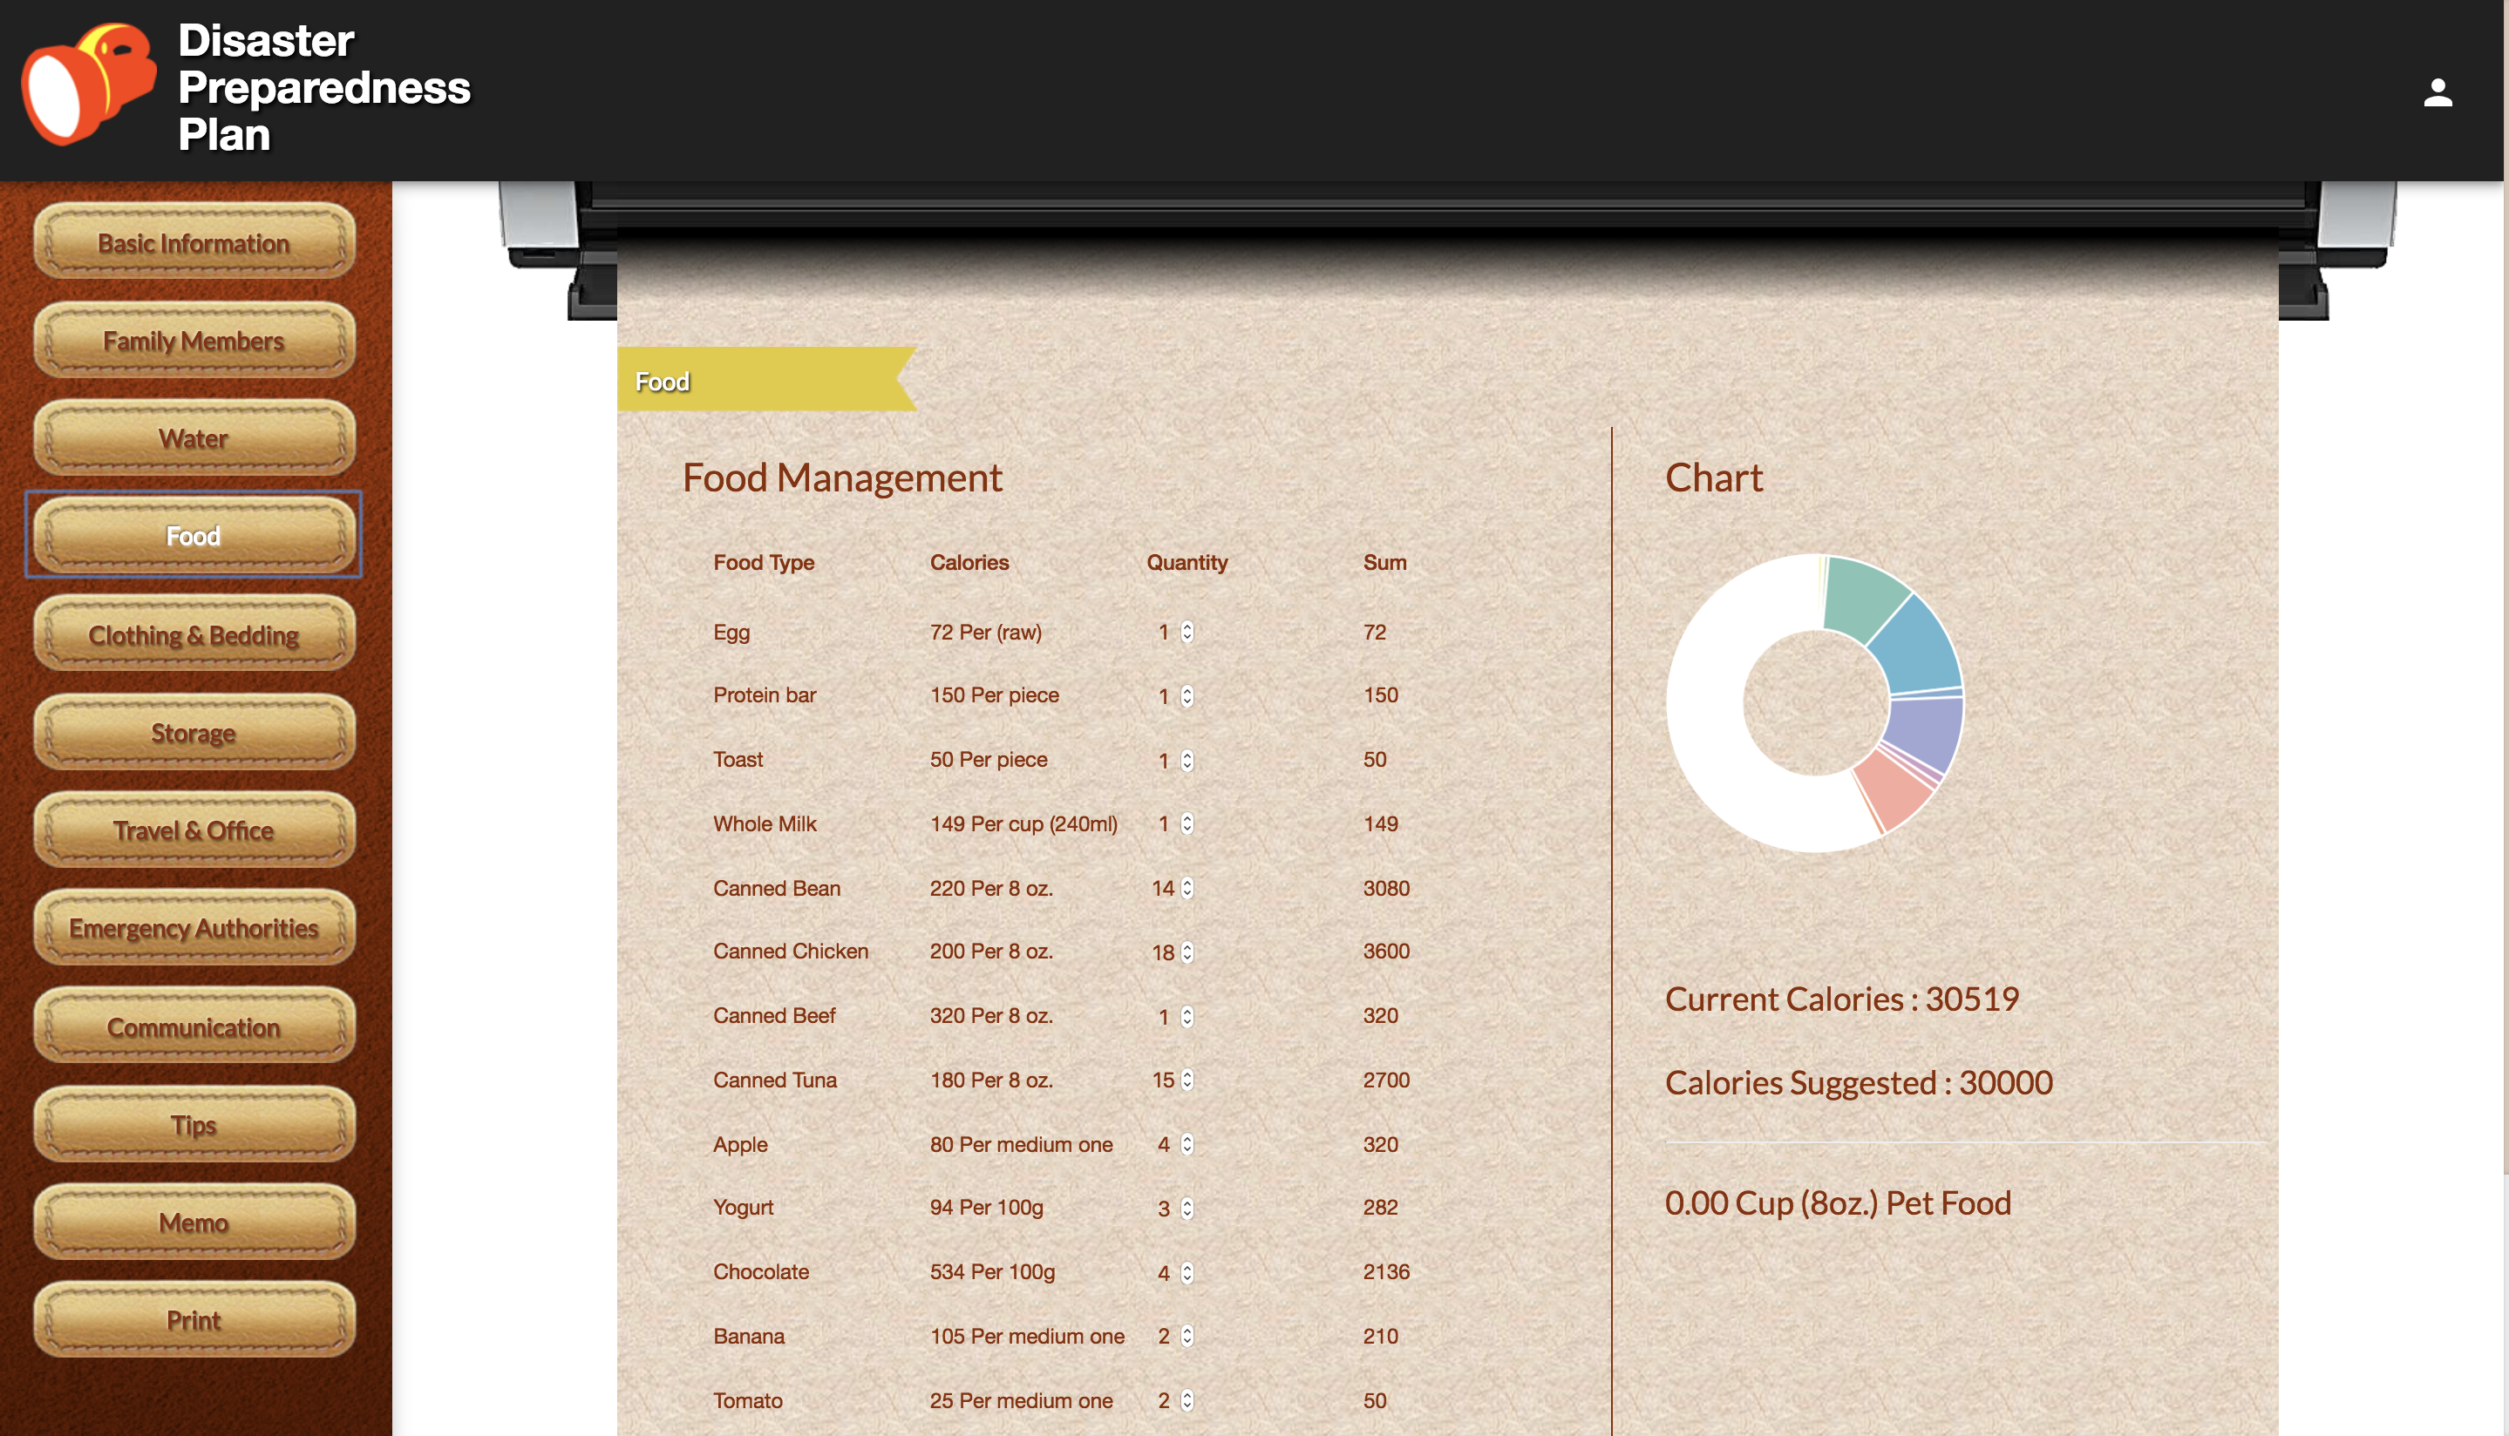

Slide 13
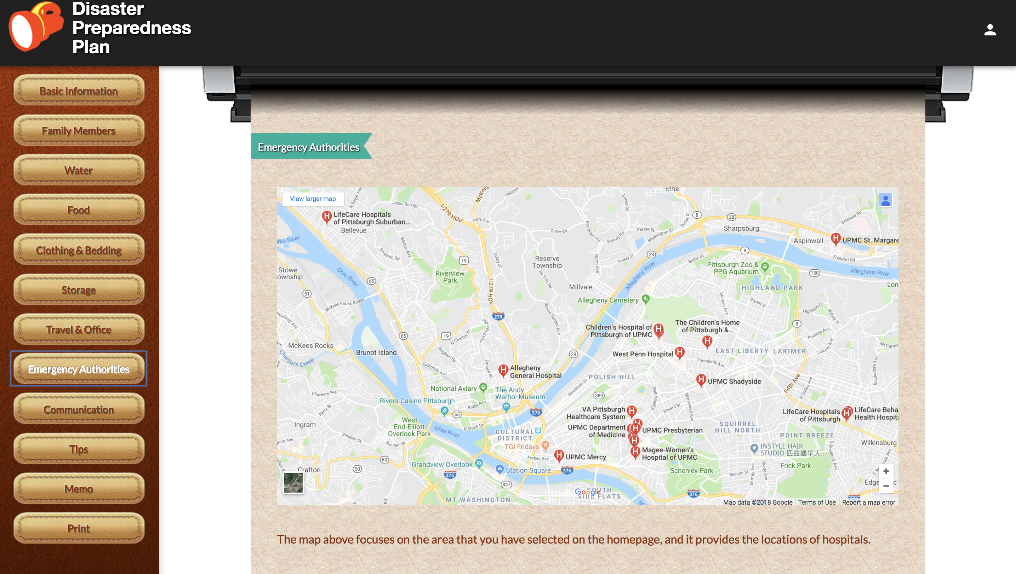

Slide 14
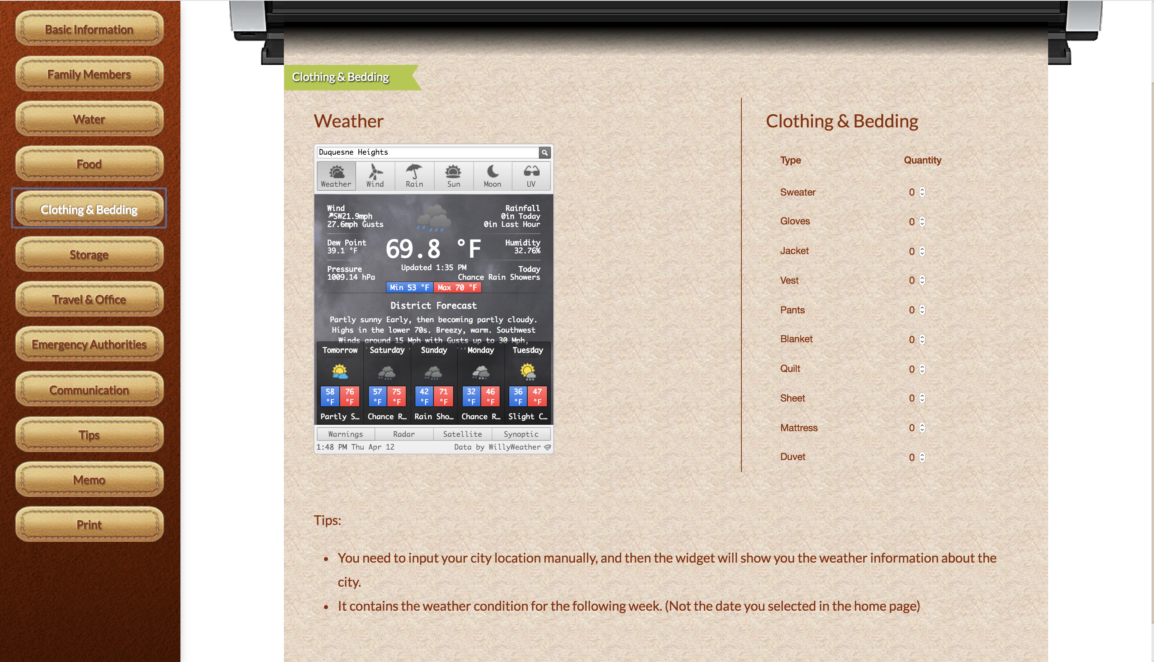
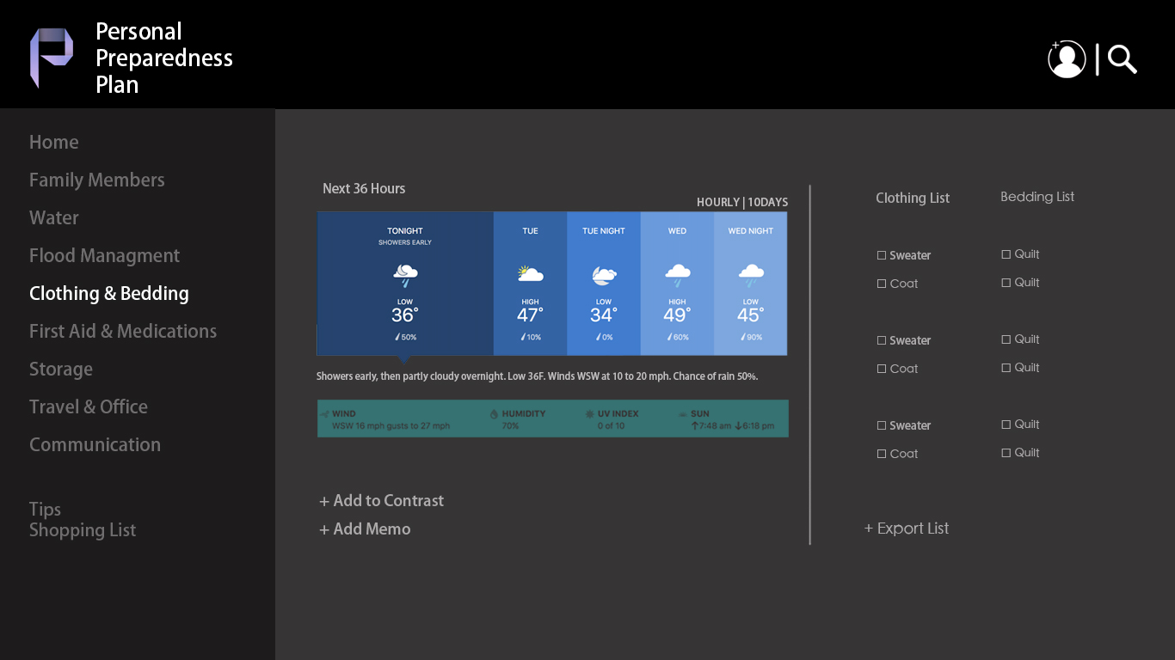

Slide 15
Technology
Front end：Angular
Back end：Flask (REST API)
Database：MySQL

